Slide 1

Big Data in Retail -By Sanika Deshpande

Slide 2
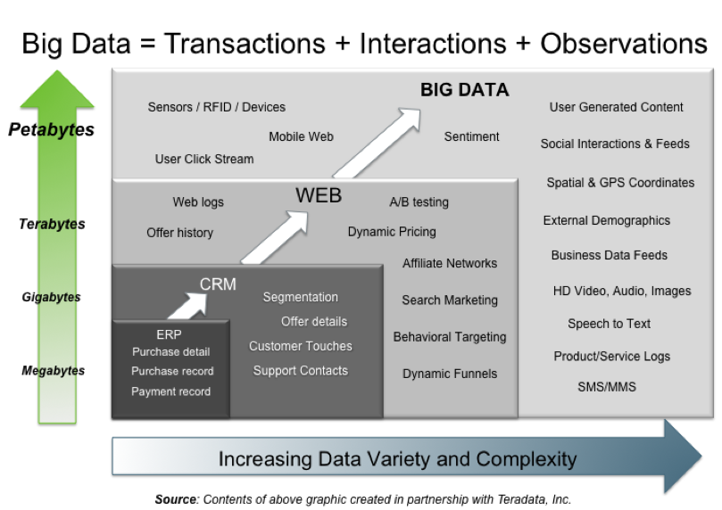
What is Big Data?
Large amount of structured and unstructured data
Petabytes or Exabyte
of data
Billions or trillions of record
Complex Inter-relationships
Incomplete Data Sets

Slide 3
Why Big Data is Important?
Main reason is to calculate the risk as lot of data is under-utilized.
To Keep eye on Customer’s Viewpoints.
To get lot of profit and growth in market

Slide 4
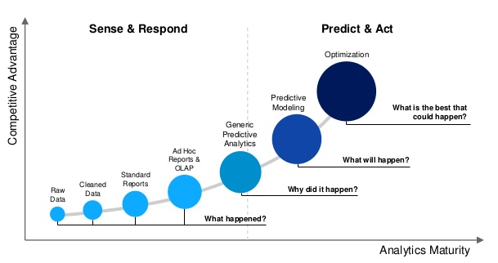
Predictive and Prescriptive Analysis

Slide 5
Predictive and Prescriptive Analysis
Retailers achieve 73% higher sales than others
Helped in getting 360 degree view of customers
Collection of accurate information

Slide 6
Big Data Analytics in Retail
Identify Consumer
Look for customer’s location and profile information in repository
Feeds the profile into real time expert system
Determine best offer for customer

Slide 7
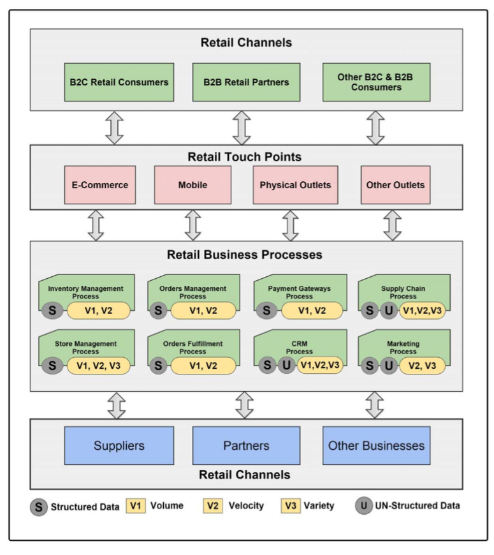
Retail Application Process

Slide 8
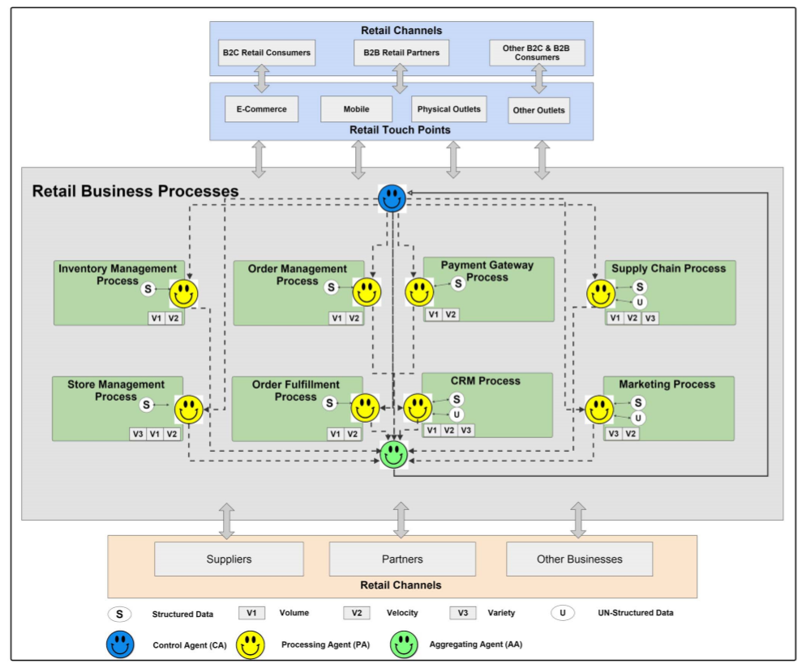
Agent-Based Big Data Analytics

Slide 9
5 Use Cases in Retail
Personalization
Envision data personalization
Using machine learning technique, behavioural targeting , purchase pattern analysis, recommendation of products
Recommendation Engines
E-Commerce Optimization
Small platform for individual retailer
Brand Evaluation
Social sentiment analyser is used.
Categorise the sentiments into positive, negative and neutral
In-Store Shopping Experience
Combine review from different sources
Engage the customer
Dynamic Pricing
Repricing Engine
Market trends ,consumer demands and competitor prices
Max and Minimum limit of price

Slide 10
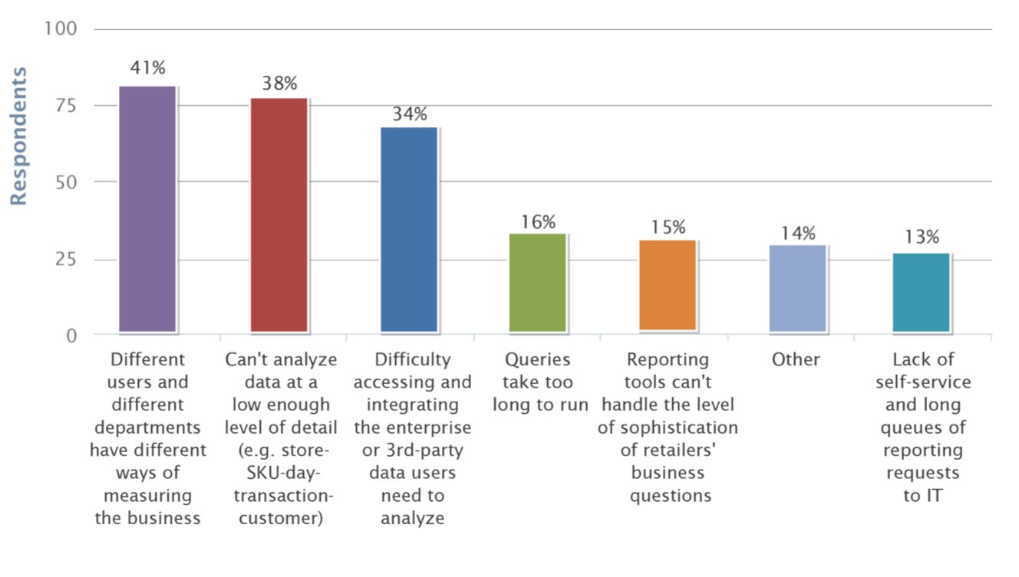
Retailer’s Biggest Obstacle

Slide 11
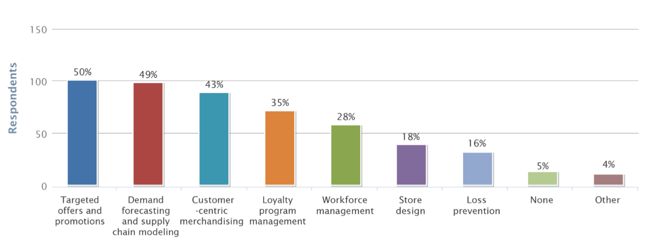
Big Data’s Impact on Retailers

Slide 12
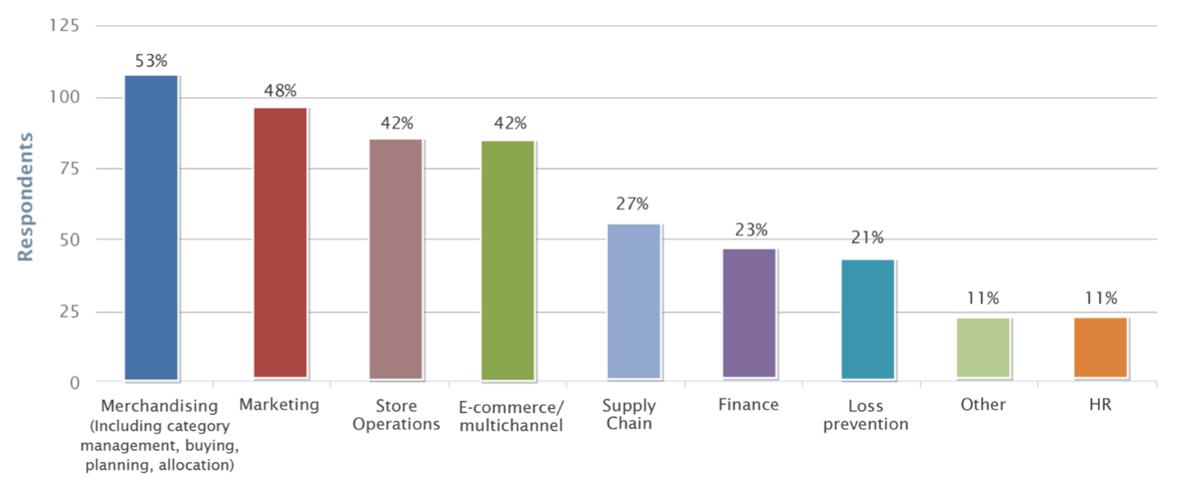
Benefit From Big Data

Slide 13
Examples
Macy’s Price Optimization
876 stores in 45 states
It Auto-adjust the pricing for higher sale
Analysis Speed is increased due to cloud-based solution
Daily, 270 million factors in 20 minutes across 73 million products
Time reduced from 22 hours to 20 minutes.

Slide 14
Examples
Tesco’s Inventory Management
Traditionally, If order in bulk then get discount.
But, Tesco deals with individual Pieces.
Runs some model to analyse the drop percentage
In case of Storage Management, Capacity to hold 12000 items from 700 suppliers.

Slide 15
Examples
Kroger’s Promotion Analysis
CEO, David Dillon, “Big Data is Secret Weapon in Grocery Store”.
Have most sophisticated and influential retailer database
Mailing of coupons to 11 million households on regular basis from which 97% are personalized
In 2 years, 40 billion purchases from 4 billion shopping trips and 300 terabytes of data sifts by team
Big data analytics managed annual revenue in excess of $100 million.

Slide 16
Advantages
Increases Speed of Analysis
More Strategic and Combine work of IT and Business
Give real-time decision making to retailers
Avoid offer spam

Slide 17
Challenges
Customer Predictions
Changing Trends
Sentiment Analysis for Market Reputation

Slide 18
Conclusion
To improve the growth in market retailer started using big data analytics
Performance time of completing task has increased
Helped in decision Making
In short, Getting more benefits than challenge they face.

Slide 19


